Slide 1
TWITTER SENTIMENT ANALYSIS
By:-
KHUSHI SHARMA (020) KRITIKA ARORA (356)
ROSHAN THAKUR(045)

Slide 2

Aim
The main goal is to connect on Twitter and search for the tweets that contain a particular keyword and then evaluate the polarity of the tweets as positive, negative or neutral.
A Twitter sentiment analysis is the process of determining the emotional tone behind a series of words, specifically on Twitter. A sentiment analysis tool is an automated technique that extracts meaningful customer information related to their attitudes, emotions, and opinions.

Slide 3
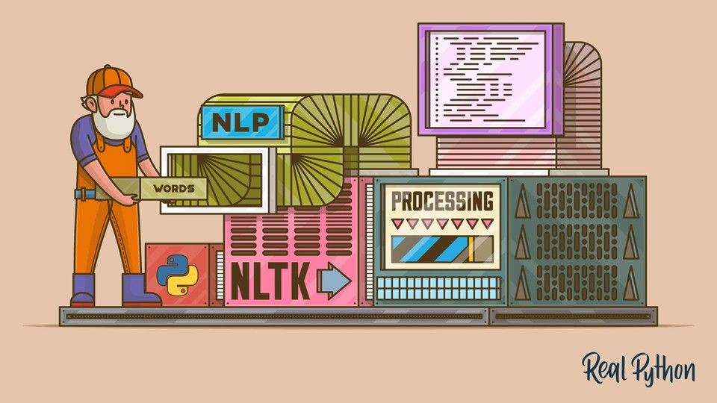
NATURAL LANGUAGE TOOLKIT (NLTK)
The Natural Language Toolkit (NLTK) is a platform used for building Python programs that work with human language data for applying in statistical natural language processing (NLP). It contains text processing libraries for tokenization, parsing, classification, stemming, tagging and semantic reasoning

Slide 4

SNOWBALL STEMMER
Stemming is important in natural language processing(NLP).
It is the process of reducing the word to its word stem that affixes to suffixes and prefixes or to roots of words known as a lemma. In simple words stemming is reducing a word to its base word or stem in such a way that the words of similar kind lie under a common stem. For example – The words care, cared and caring lie under the same stem ‘care’

Slide 5
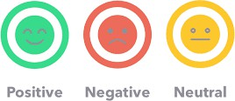
SENTIMENT ANALYSIS USING VADER
VADER is an unsupervised learning algorithm
VADER (Valence Aware Dictionary and sEntiment Reasoner) is a lexicon and rule-based sentiment analysis tool that is specifically attuned to sentiments expressed in social media.
VADER uses a combination of A sentiment lexicon is a list of lexical features (e.g., words) which are generally labeled according to their semantic orientation as either positive or negative. VADER not only tells about the Positivity and Negativity score but also tells us about how positive or negative a sentiment is.

Slide 6
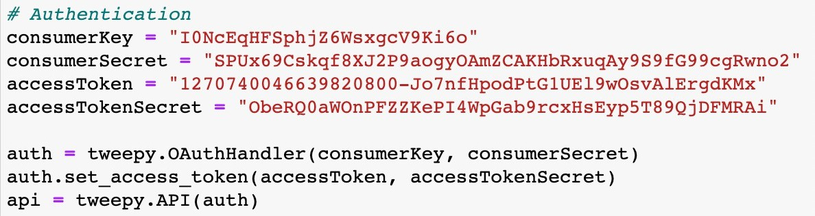
Authentication
For authentication, we had to apply for a Twitter developer account so as to use twitter's API services

Slide 7
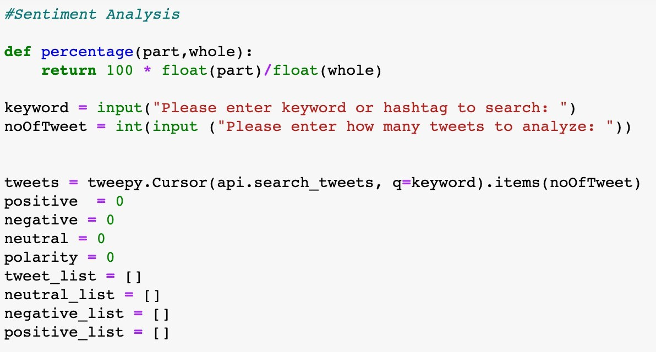
Sentiment Analysis

Slide 8
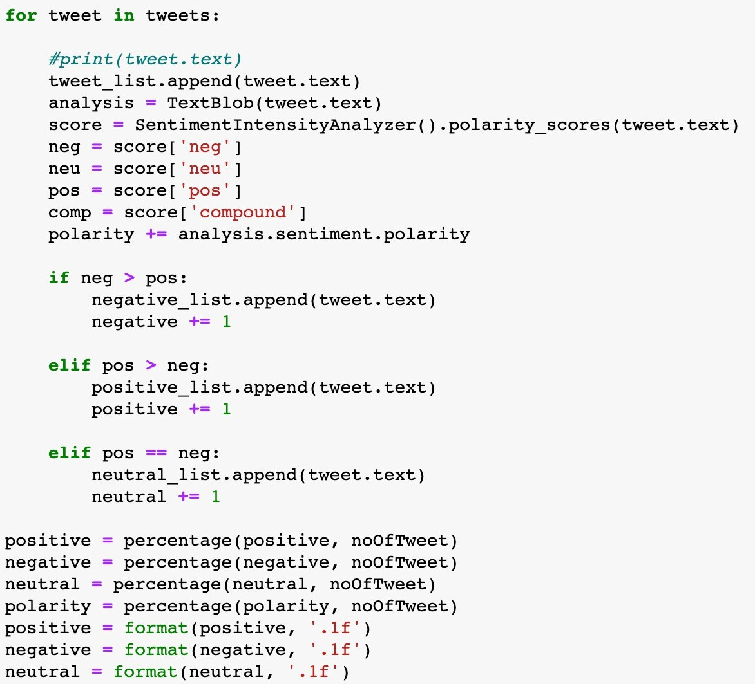
Separating the tweets list into Positive, negative, and neutral tweets list

Slide 9
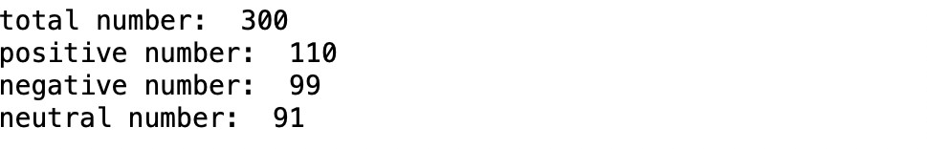
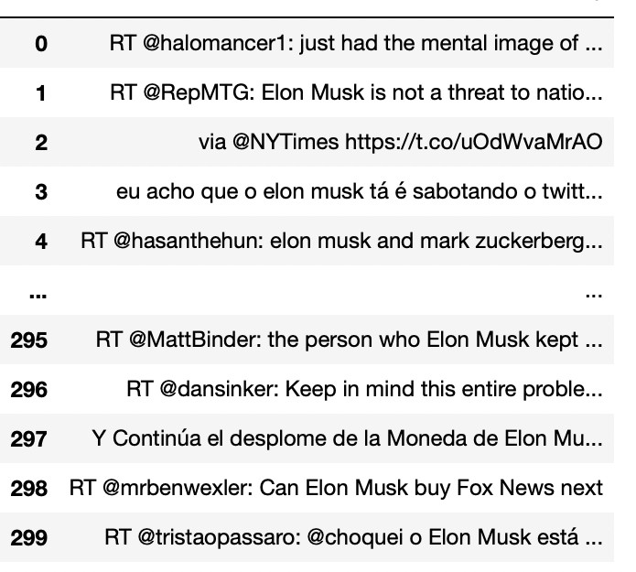
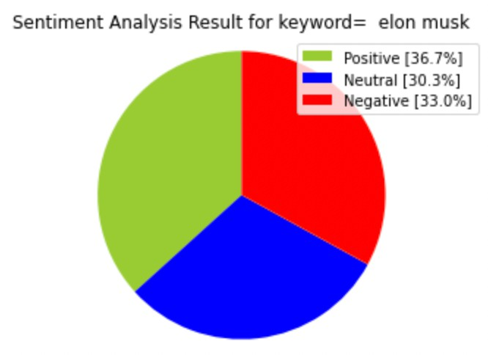
User input
Output

Slide 10
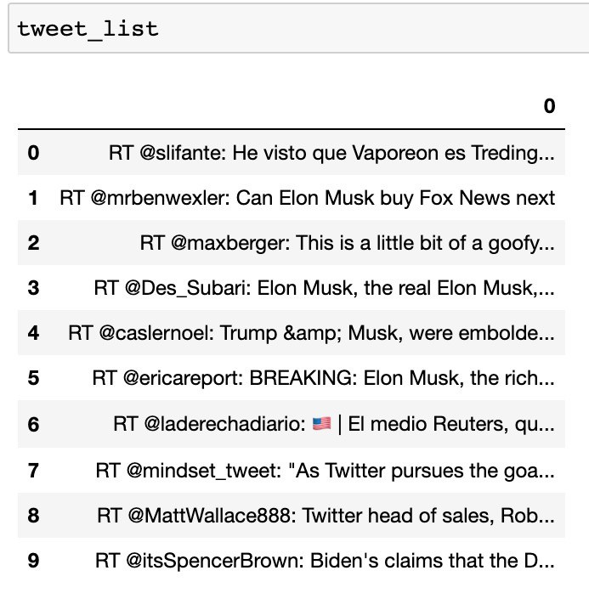
Tweets collected through API
The query for printing all the tweets which were analyzed
Analyzed tweeets

Slide 11
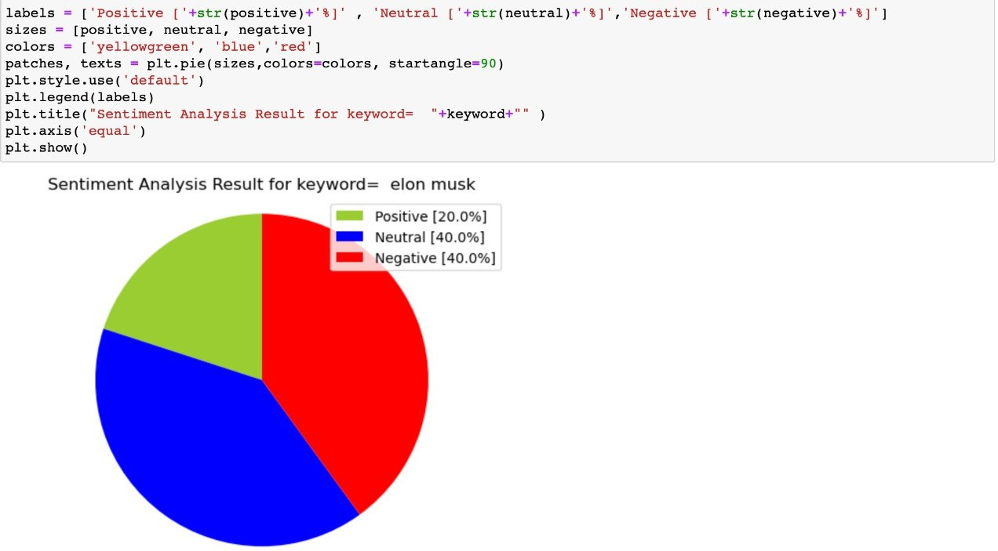

Representing the positive, neutral, and negative Tweets in the form of a pie chart
Sentiment analysis result

Slide 12
TEST EXAMPLES
Positive Negative Neutral
Elon musk
Electric vehicles
Covid
Education
0
50
100
150
200

Slide 13
Why is Sentiment Analysis important ?
We can make sense of a company’s qualitative data with sentiment analysis when the information is gathered through different platforms.
Voice of Customer (VoC) Programs
Voice of Customer (VoC) Programs is the feedback gathered better to understand customers’ feelings and concerns about a brand. This is crucial for the improvement of customer experience.
Customer Service Experience
An extraordinary client benefit involvement can make or break a company. Assumption examination can diminish handling times and increase productivity by coordinating questions with the correct people.
Market Research
Sentiment analysis can offer assistance for companies to distinguish new trends, analyze competitors, and test emerging markets. Companies may need to analyze the scores of competitors’ reviews. Using sentiment analysis to evaluate this information can help recognize what clients like or dislike about the competitors.

Slide 14
Product Experience
Sentiment analysis can identify how your clients feel about the highlights and benefits of your products or services. This may offer assistance and reveal areas of opportunity that may not have been mindful of before You may mine online item audits for criticism on a particular item category over all competitors in this showcase.
Brand Sentiment Analysis
The sentiments surrounding a brand are one of the most important factors to consider for a good customer experience. Depending on the brand sentiment, sales increase or decrease. This is also reflected in brand loyalty, where positive sentiments result in good reviews and recommendations, while negative sentiments increase customer churn rates. Sentiment analysis provides brands with tools to monitor how their customers feel about them.
Social Media Sentiment Analysis
Social media can be one of the most capable ways to reach potential clients and keep existing ones. Great client reviews and posts on social media empower other clients to buy from a company. On the other hand, bad reviews and comments can be one of the most harmful advertising out there.

Slide 15
FUTURE VISION
Our future vision with the project includes:-
can be developed as a web and phone application for easy application and use of the sentiment analysis algorithm
it is a very good tool to conduct research on various topics in different fields to test how accurate the sentiment analysis is by comparing the results to actual data
it can be incredibly useful for companies to analyze their customers and their needs, and sentiment analysis predictor using Twitter can be a perfect tool for them.
We look forward to use a larger dataset for more accurate results

Slide 16
CONCLUSION
Sentiment analysis in Twitter is a field that has recently attracted research interest. Twitter is one of the most popular microblog platforms on which users can publish their thoughts and opinions. Sentiment analysis on Twitter tackles the problem of analyzing the tweets in terms of the opinion they express. Machine learning techniques perform reasonably well for classifying sentiment in tweets and that is he sole reason why it is super important in today's world to have knowledge of the current sentiment around any area of your interest.

Slide 17


